Slide 1



^{Commission 4} Finances publiques et compétitivité/ politique industrielle / autonomie stratégique Coprésidée par
Alexis Walckiers (ULB)
Reinhilde Veugelers (KULeuven)

Slide 2

^{Commission 4} FINANCES PUBLIQUES ET COMPÉTITIVITÉ / POLITIQUE INDUSTRIELLE / AUTONOMIE STRATÉGIQUE Financement d'entreprises innovantes
Financing the EU Health Innovation:
the role of Venture Capital*
Sofia Amaral-Garcia (European Commission – Joint Research Center/ULB)
* with Reinhilde Veugelers.
Disclaimer: The contents presented here do not necessarily reflect the position or opinion of the European Commission.

Slide 3
Research question:
Is the EU-US gap in dynamic innovative performance in health related to a gap in venture capital?
Analysis of venture capital deals: how does the EU stand in comparison with the US?
Evidence of important differences (e.g., home bias, deal stages, amounts, ….)

Slide 4
Innovation and competitiveness in the EU
Draghi report:
Europe must close the innovation gap with the US and China, especially in advanced technologies.
European companies spend less in Research&Innovation than US firms.
EU has talent but we must translate innovation into commercialisation
“Many European entrepreneurs prefer to seek financing from US venture capitalists and scale up in the US market”.

Slide 5
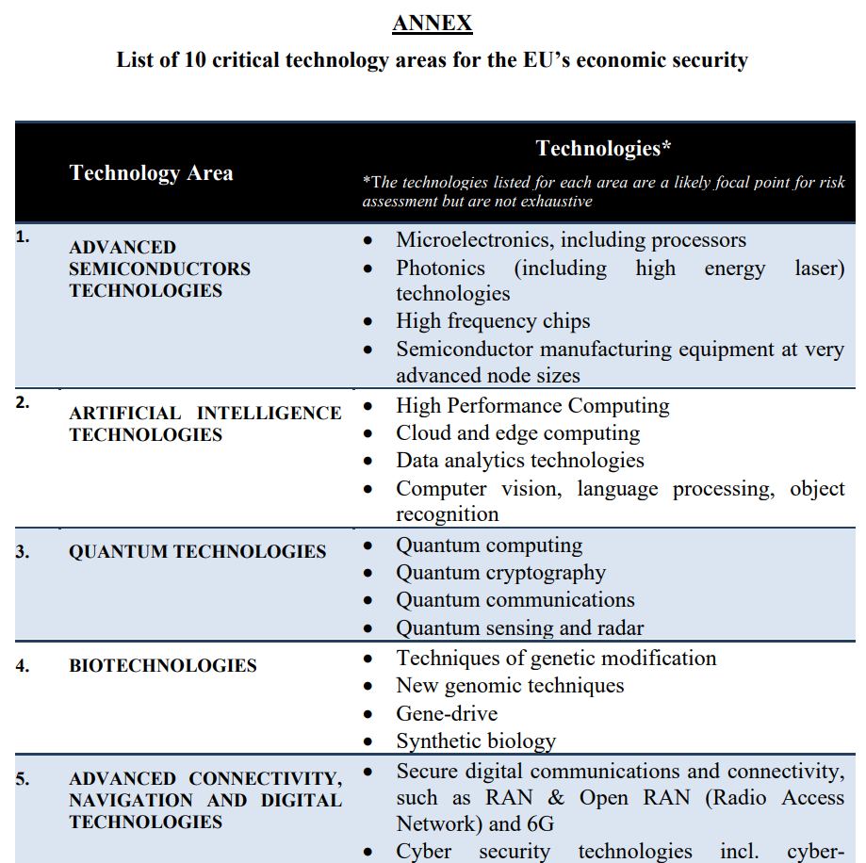
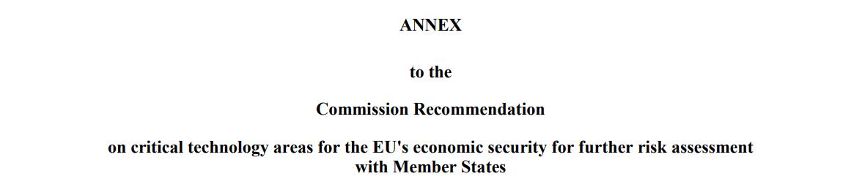
Health & Biotech
Health: one of the largest R&D-intensive sectors in Europe (approx. 20% of global R&D).
Biotech is among the 4 technology areas with the highest likelihood of presenting the most sensitive and immediate risks related to technology security and technology leakage.

Slide 6
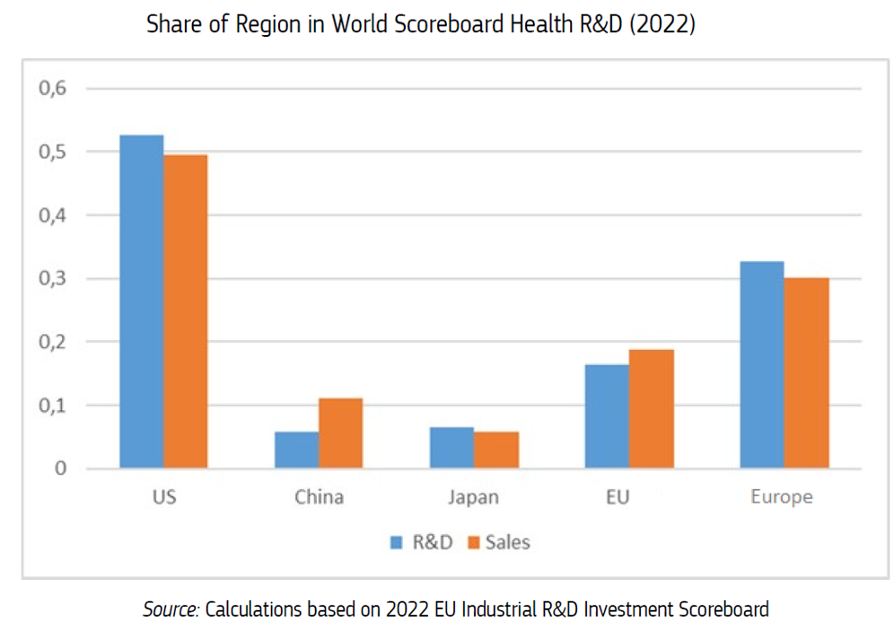
Motivation: Europe’s position at the health innovation frontier
The EU is challenged by a persistent leadership of the US:
US firms account for more than half of world Industrial Scoreboard Health R&D in 2022.
Veugelers and Amaral-Garcia (2025).

Slide 7
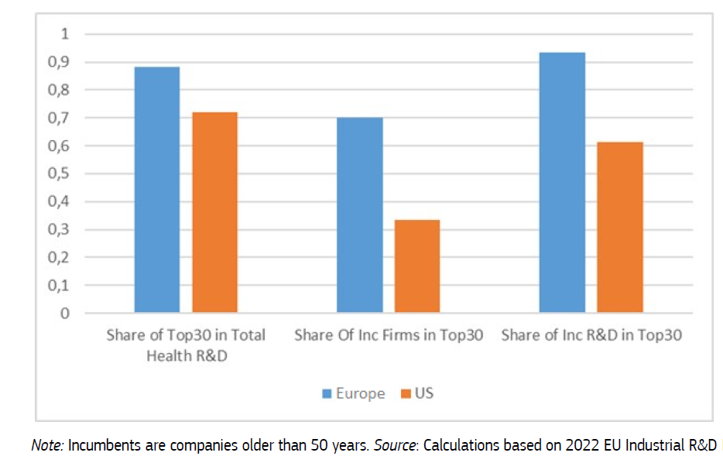

Incumbents vs New firms
Incumbent and New leading Firms in Health R&D (Europe and US)
The European health innovation landscape is more concentrated, and more of its leading firms are “incumbents”.
The US has a larger share of leading firms to be newer firms, that challenged incumbents, suggestive of the larger scope of new US health firms to grow faster to leading innovator status.
More Schumpeterian creative destruction.
Veugelers and Amaral-Garcia (2025).

Slide 8
Financing constraints in health
Financing constraints are particularly relevant in health and biotech:
Significant time lapse from initial R&D until final market access
High regulatory and technology uncertainty
Access to finance is particularly relevant for risky breakthrough ideas and technologies
More likely to be introduced by new finance-constrained players (e.g., mRNA COVID-19 vaccines (Veugelers, 2022); see also Aghion, Amaral-Garcia, Dewatripont & Goldman, 2020 for the role of public investment).
Evidence of underinvestment in novel drugs (Krieger et al. 2022)
US Venture capitalists play an extremely important role in driving innovation in the health and biotech sector (Chandra et al. 2022)

Slide 9
Access to finance
To assess the dynamics of Europe’s innovative potential in health, we need to better understand the financial constraints faced by start-ups and scale-ups in the health sector.
Is the EU-US gap in dynamic innovative performance in health related to a gap in venture financing constraints?
We analyse venture capital financing for health projects in the EU compared to the US, using data from Dealroom.

Slide 10
Data
Dealroom data
Extensively used to monitor development of startups (De Nigris et al., 2020)
We consider investment deals involving targeted companies with headquarters in Europe (EU-27, UK and Switzerland) or the US
Time frame: 2013-2021
Information about: investee (e.g., HQ location, description of activities), investor (e.g., HQ location), deal (round, amount, date).
Use of text mining to categorize investee’s fields of business/deals (e.g., biotech, cancer, artificial intelligence)
Webscraping to characterize VC investors

Slide 11
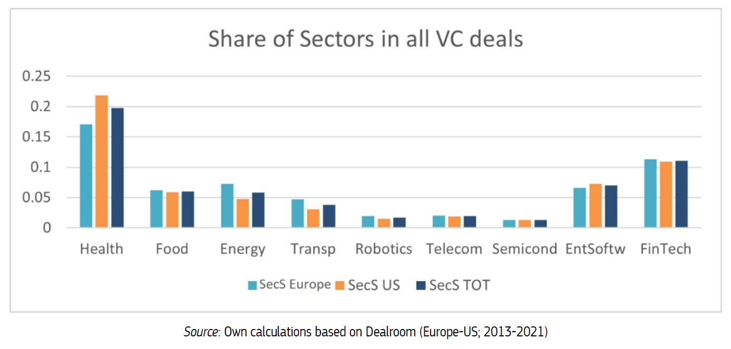
Health: largest sector in VC deals, but...
From over 268,000 deals, approx. 19% were to the Health sector
Notes:
Health accounts for the highest proportion

Slide 12
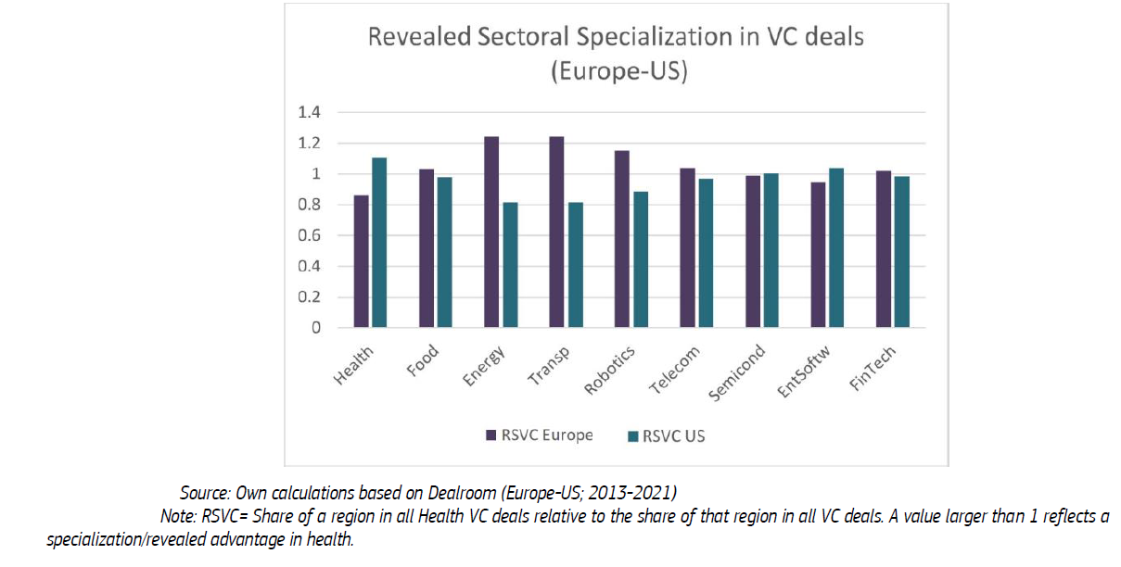
…Europe is not specialized in Health VC

Slide 13
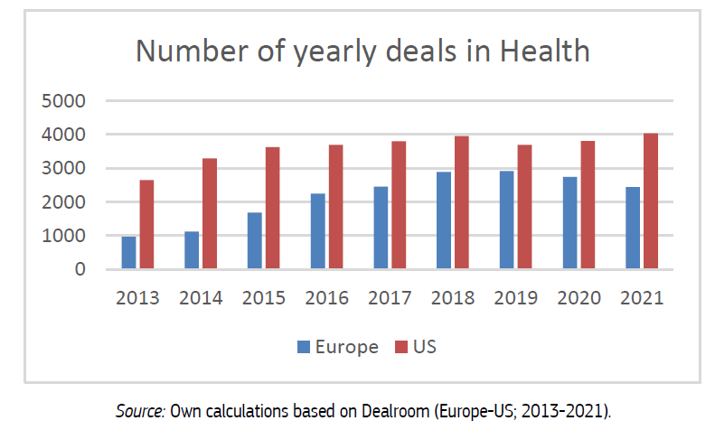
Gap Europe-US: Number of VC deals
Increase, with waves.
Gap EU-US: decreased (2018/19), then increased again

Slide 14
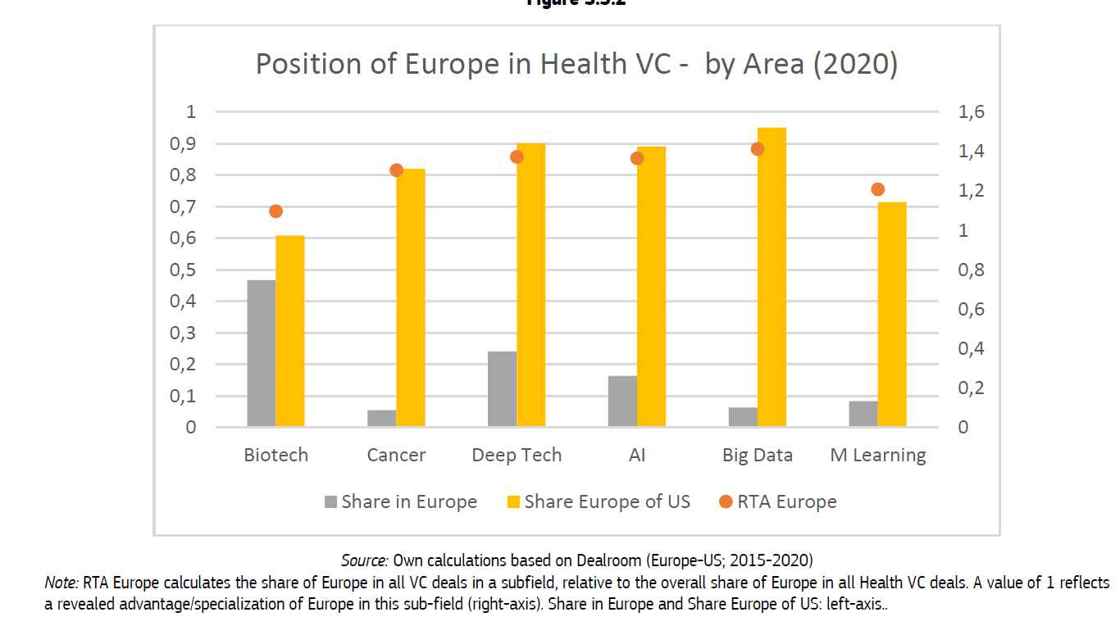
Technology areas
Biotech: major sector for Health VC deals
Number of deals in Deep Tech, AI, Big data is almost the same in Europe as in the US
Notes:
Revealed Technology Advantage

Slide 15
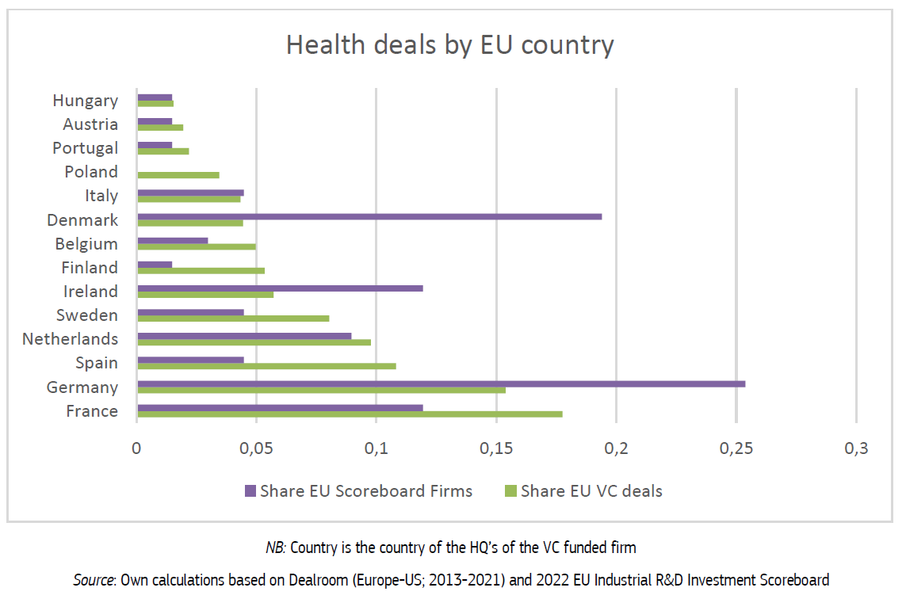

Slide 16
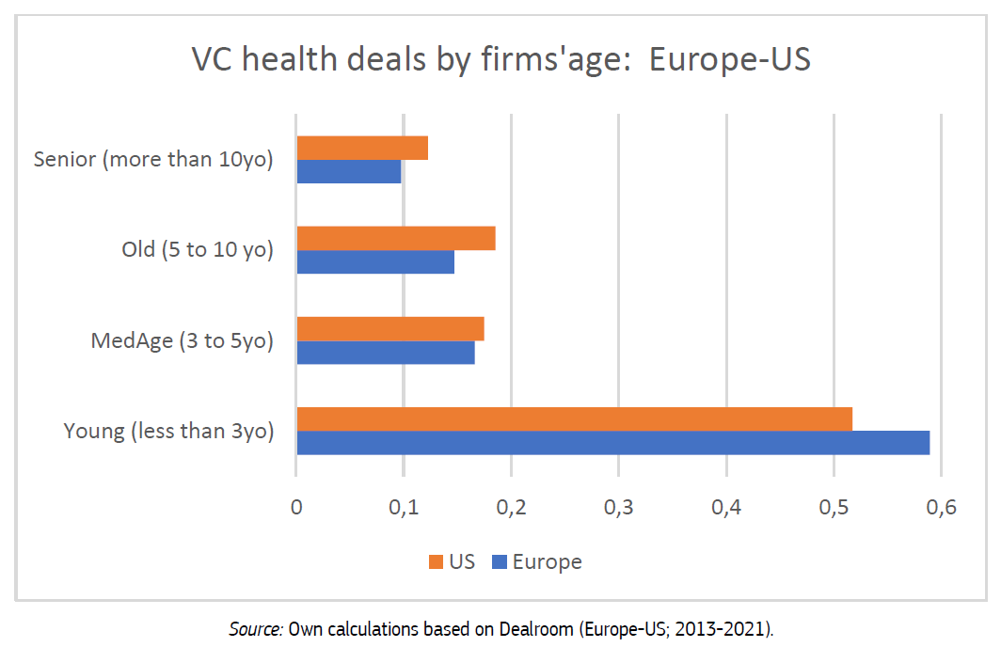
Investee’s firm age

Slide 17
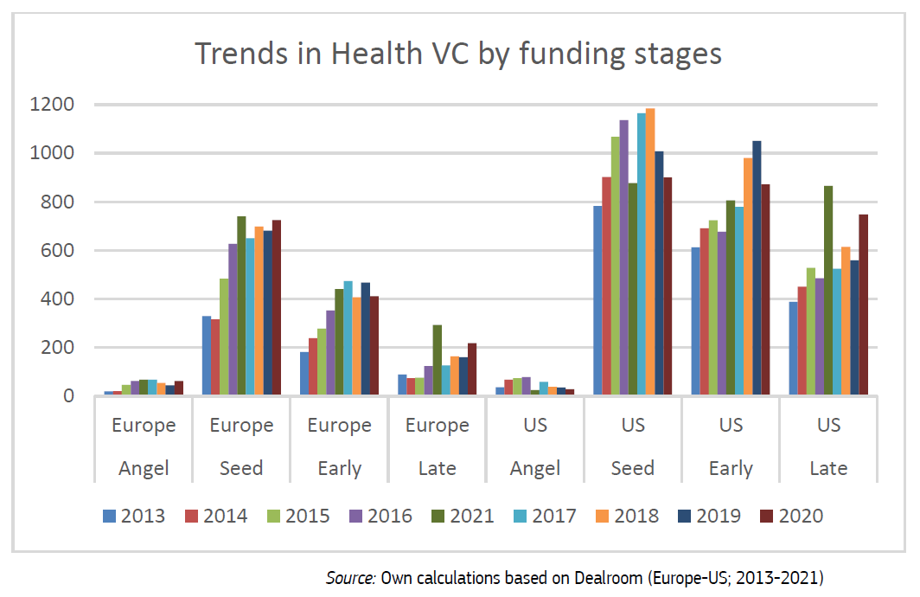
Funding stages
Largest gap: Late stage
EU investees face more challenges when scaling up.
Notes:
Late stage: in spite of Europe’s growth rate, it represent a modest growth increment.
The gap is the largest: European deals at this stage represent 25% of the US equivalent.

Slide 18
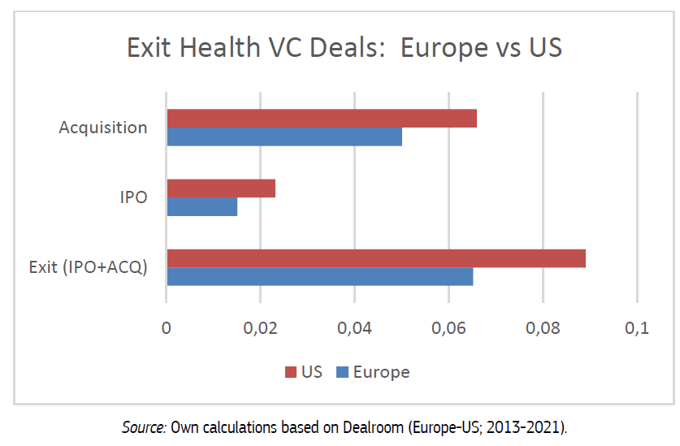
Exit strategies
In the end of the “venture cycle”, the VC firm exits successfully from the deal and returns capital its investors.
How?
Acquisition
Initial Public Offering (IPO)
Fewer exits in Europe
Less matured market
Notes:
IPO: typically better outcome

Slide 19
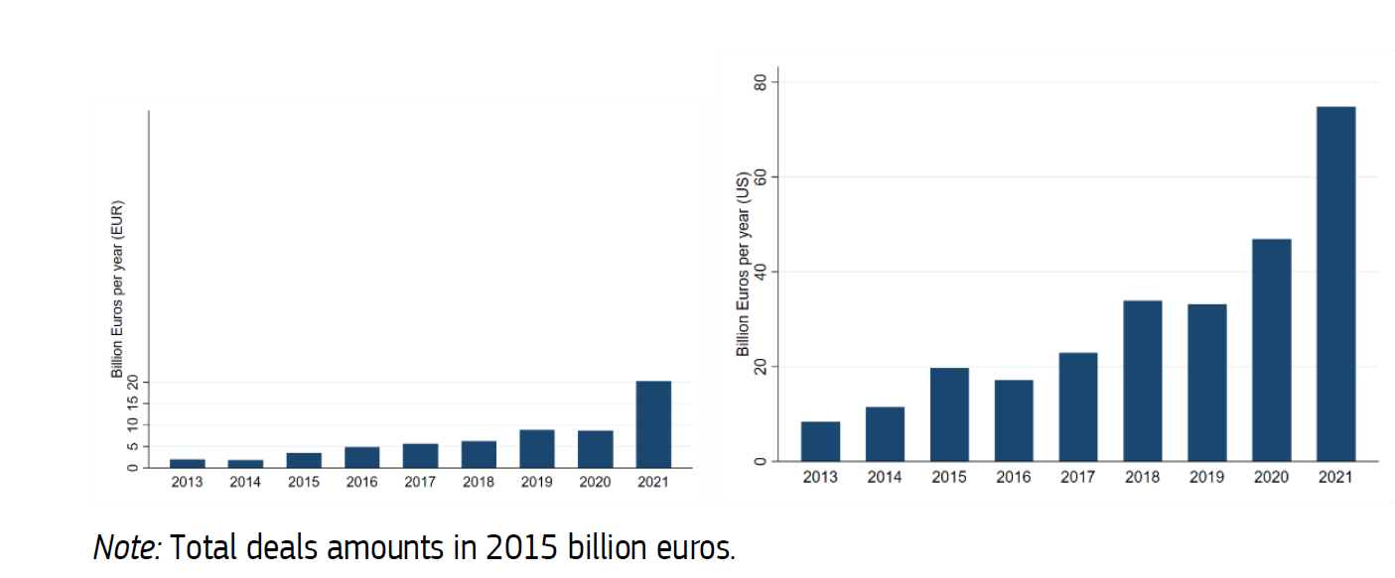
VC deal size
Total deals amounts according to companies Headquarter region of location (Europe or US)

Slide 20
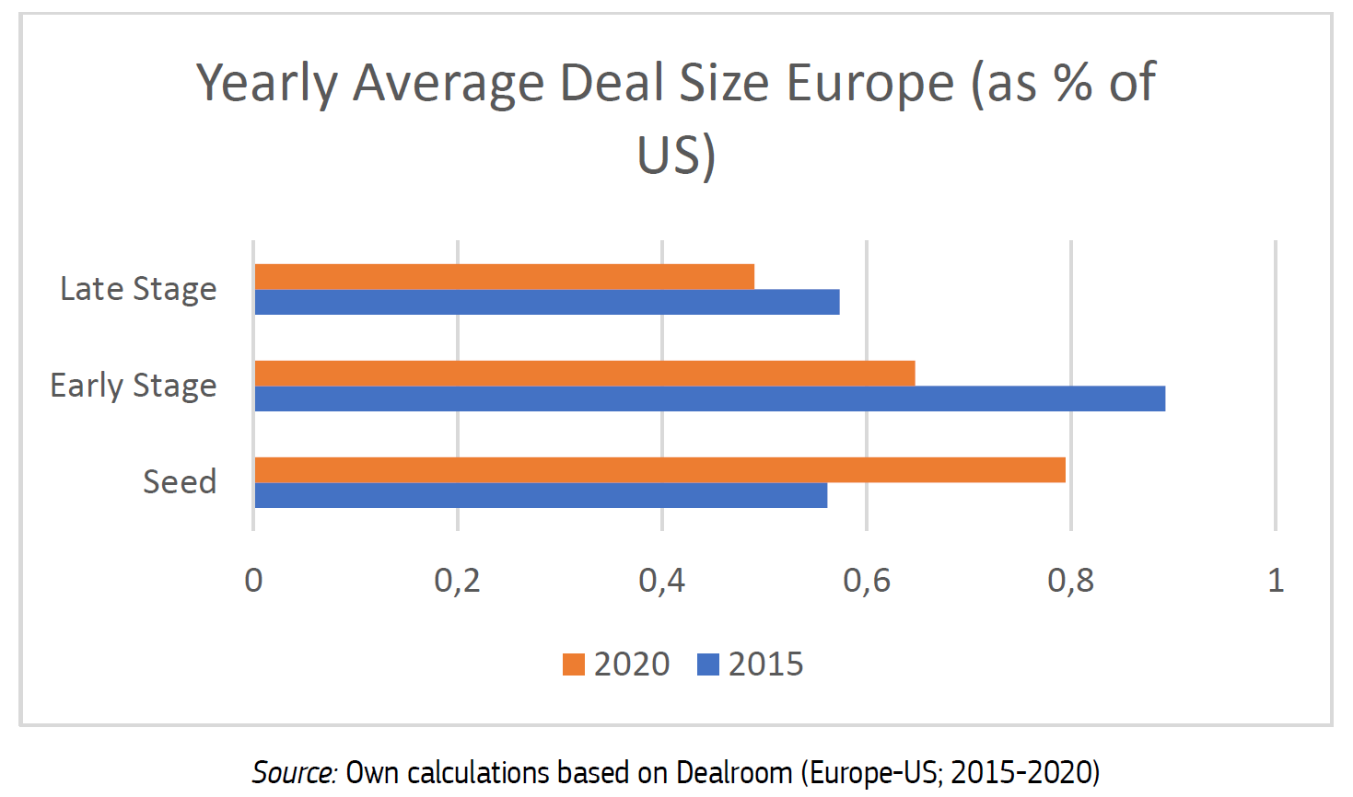
VC deal size by stage
Notes:
Overall Average EU: 12mil .Average US: 26mil
Avg Late Stage in 2020: EU=27mil. US=59mil.

Slide 21
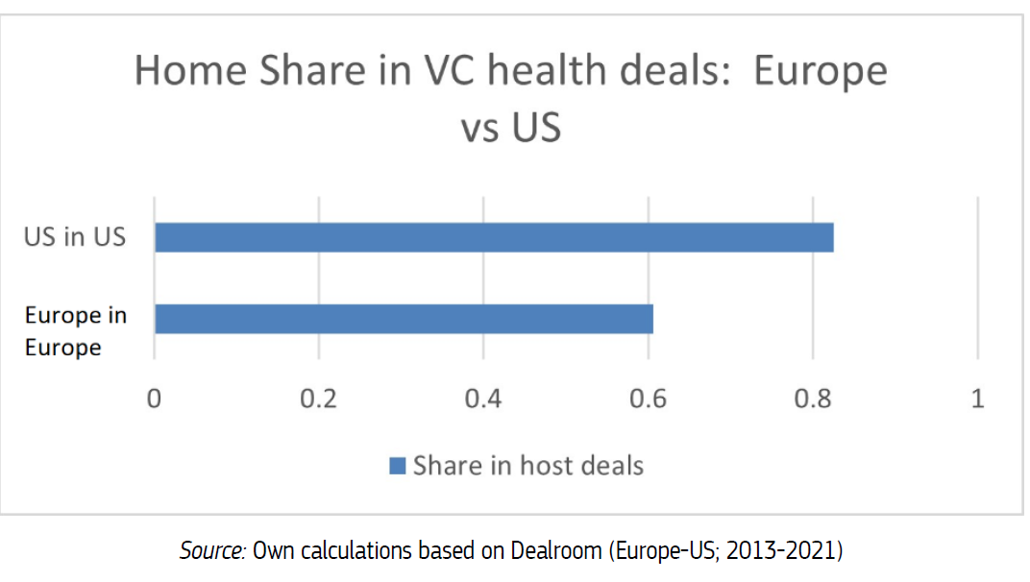
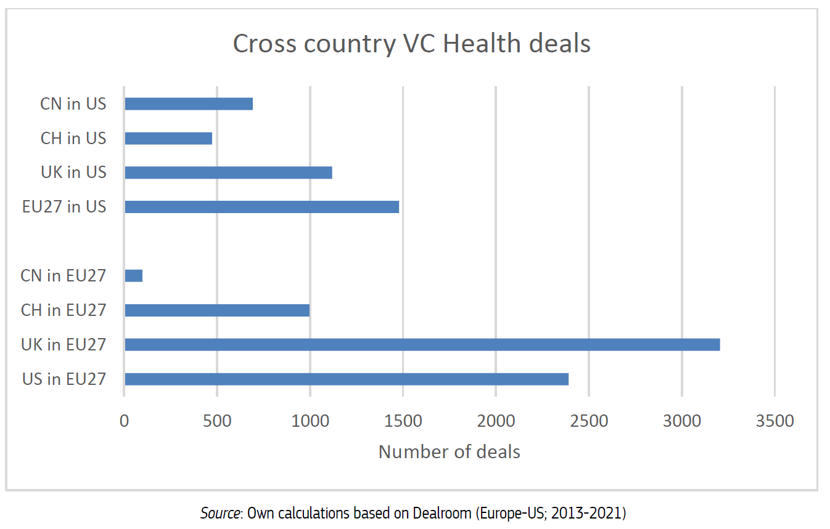
Home bias
Smaller in Europe than in the US

Slide 22
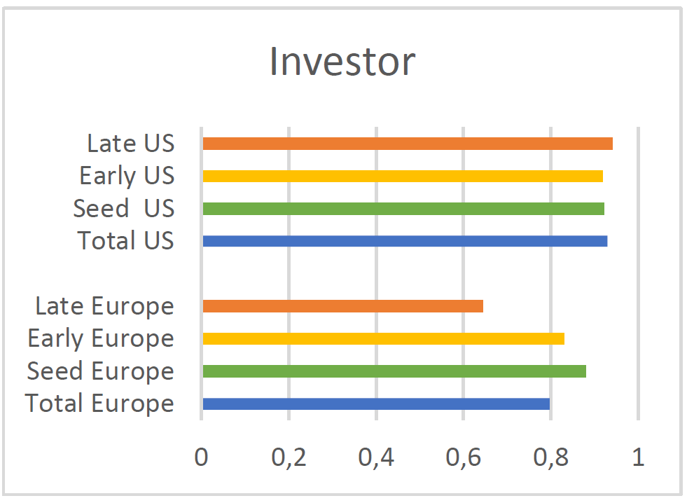
Home bias by stage
Share of deals at home, by stage
Home bias is smaller for European investors in late stages

Slide 23
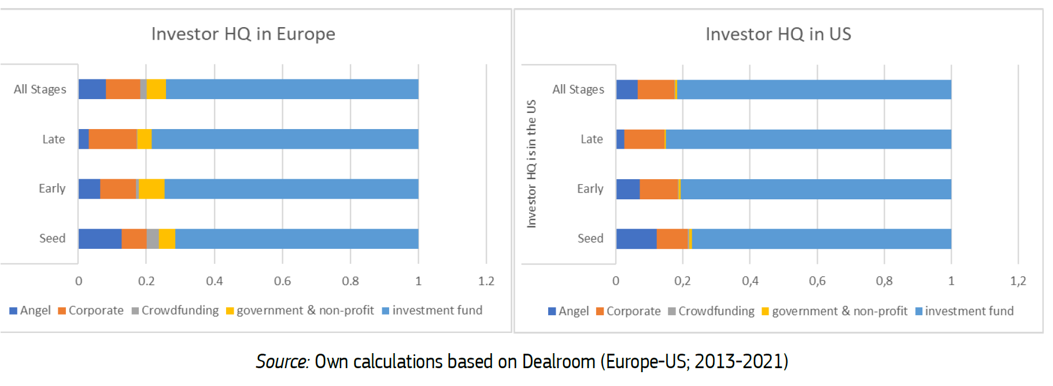
Investor type by stage
Investment funds take up the majority of deals, in all stages – even more so in Late stages.

Slide 24
Large investors
The larger the investor, the smaller the home-bias.
 | Europe Investors (N=61) |  |  |  | US Investors (N=159)
Total Number of deals by investor | >200 | 100-200 | 50-100 | 30-50 | >200 | 100-200 | 50-100 | 30-50
Number of Investment Funds | 0 | 1 | 10 | 34 | 5 | 19 | 51 | 71
Share of Investment Funds in all investors |  | 20% | 56% | 90% | 100% | 95% | 96% | 88%
Share of all deals |  | 6% | 31% | 63% | 14% | 23% | 34% | 28%
Share of deals in US |  | 28% | 20% | 26% | 88% | 93% | 93% | 93%
Share of deals in Europe |  | 73% | 81% | 74% | 13% | 7% | 7% | 7%
Note: Considering only “big” investors, i.e., those involved in more than 30 deals.

Slide 25
Conclusions
VC in health and biotech: gap between Europe and the US (US strongly specialized in Health VC deals)
Biotech: the major sector (almost 50% of all deals)
Deep Tech, AI/Machine Learning/Big Data: Small share of deals, but Europe almost catch up with the US
The gap is more pronounced in the Late stage (number of deals and average amount)
Fewer deal exits in Europe: less mature market
Home bias is smaller in Europe
Differences in access to VC might drive differences in the Europe-US innovative performance in health

Slide 26
Conclusions
Firms with new disruptive breakthrough projects should be able to reach critical scale and/or challenge incumbents.
Europe is missing large size investors.
Need for reducing barriers for European health firms to grow to a critical scale.
Europe should further develop its Open Single Market, reducing the fragmentation in flows of venture capital.

