Slide 1



INTERFACULTY MODULE
IN TRANSLATIONAL MEDICINE
DRAFT PROGRAM 2017

Slide 2
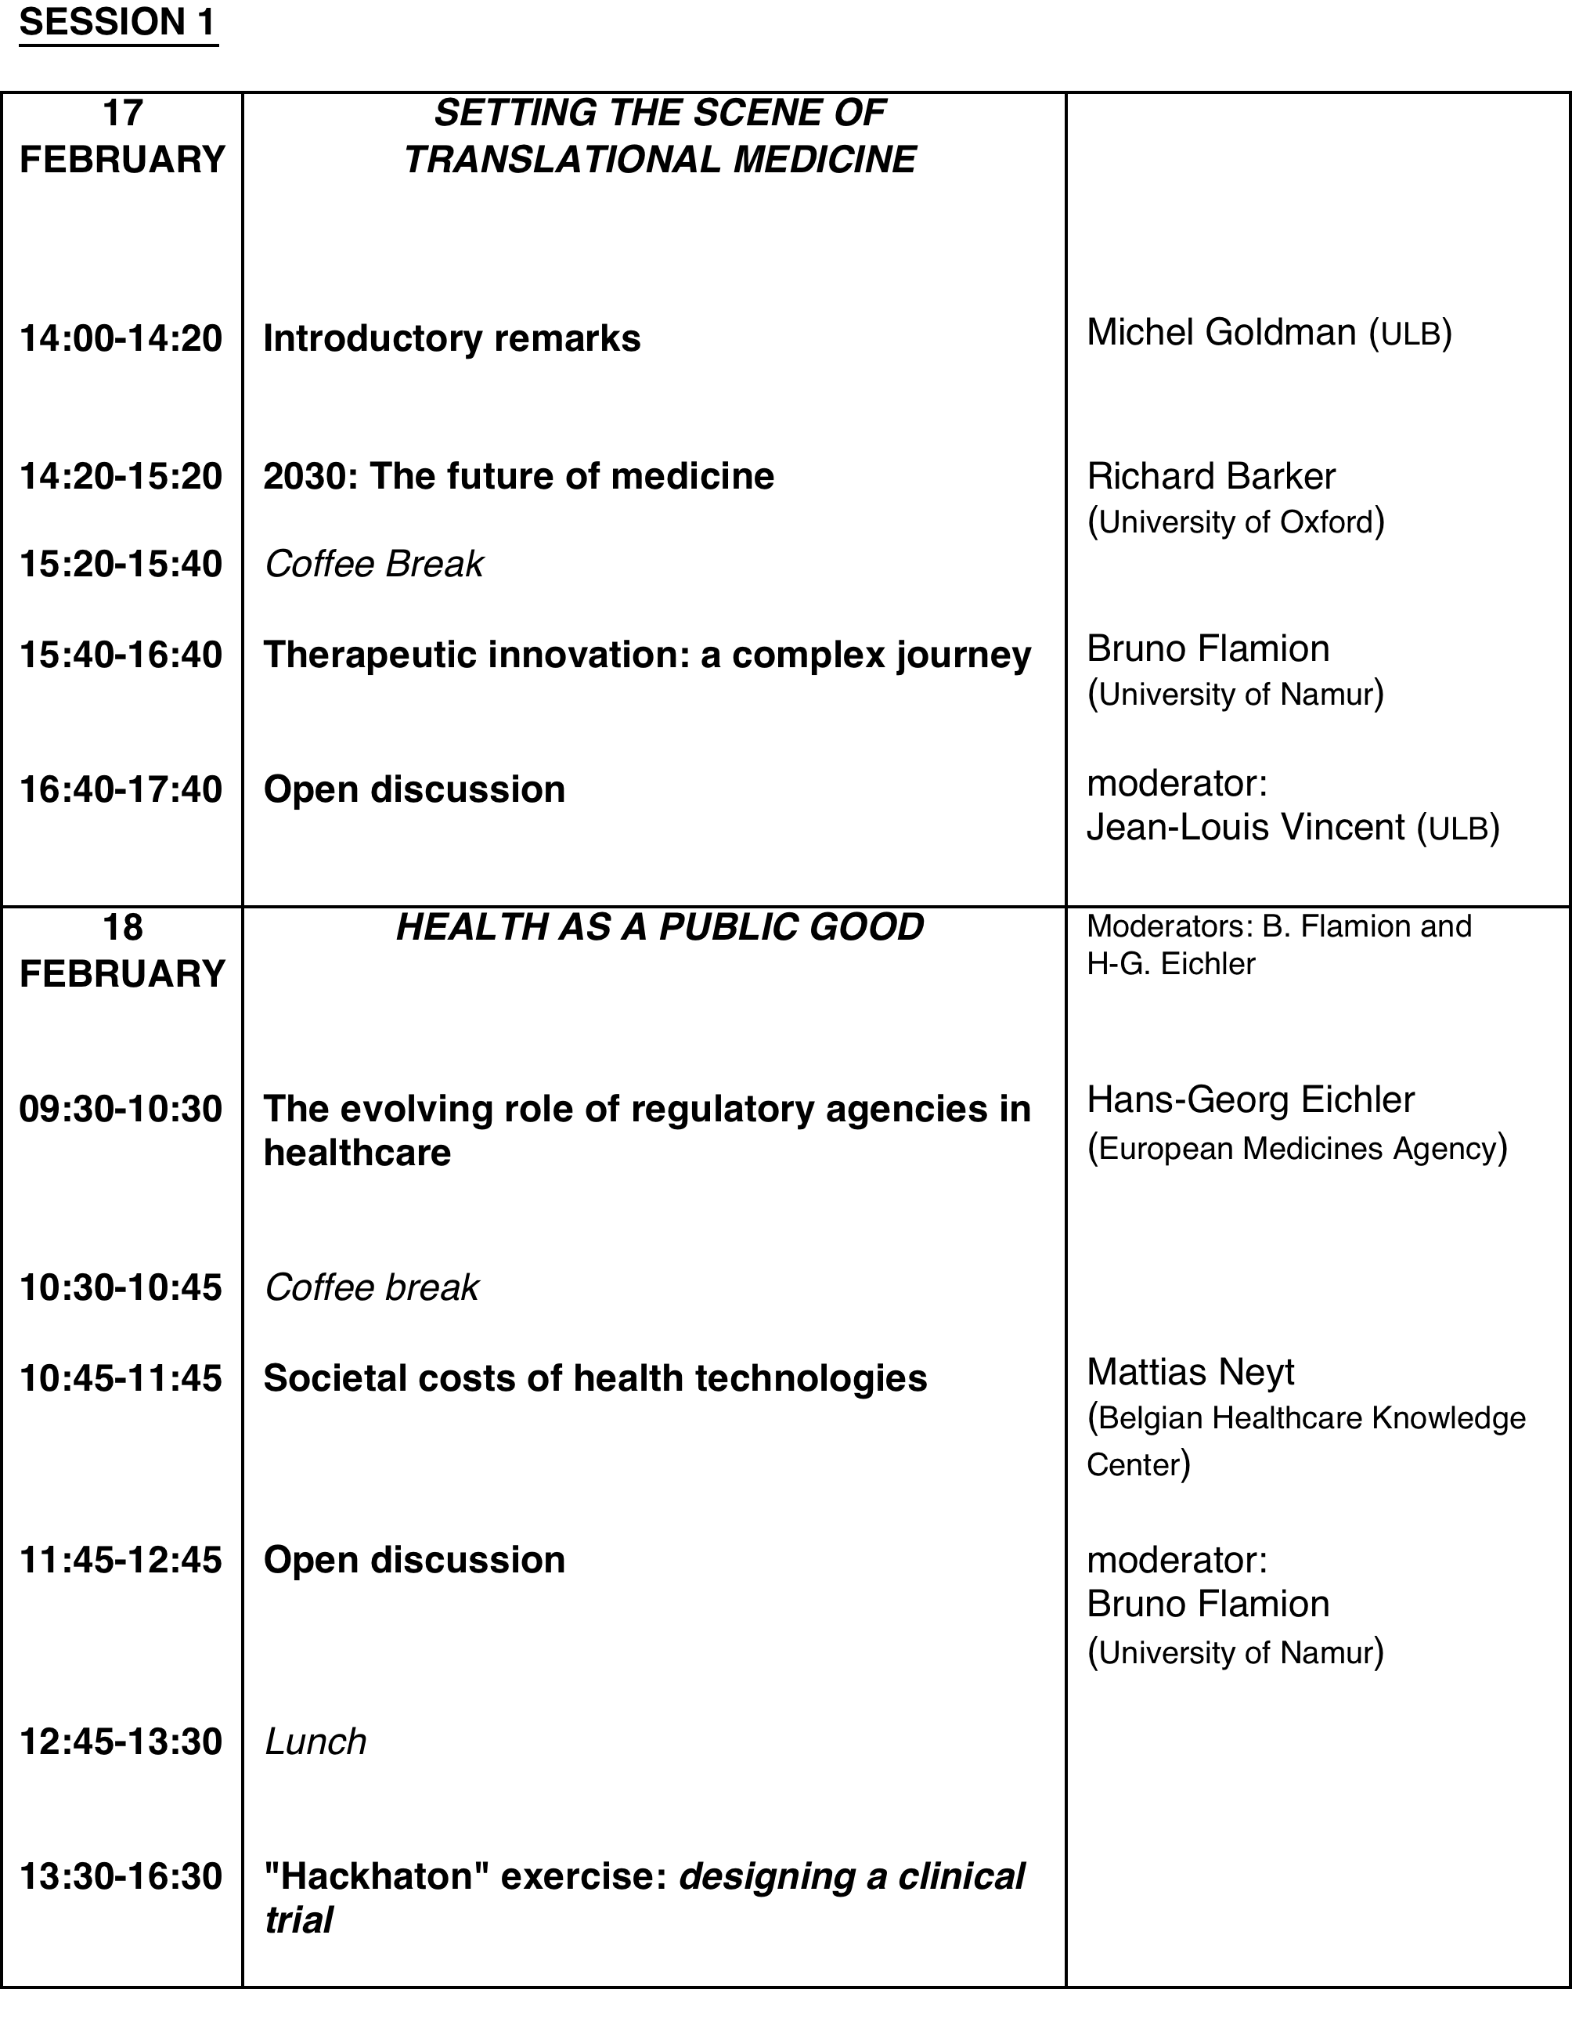
INTERFACULTY MODULE IN TRANSLATIONAL MEDICINE DRAFT PROGRAM 2017

Slide 3
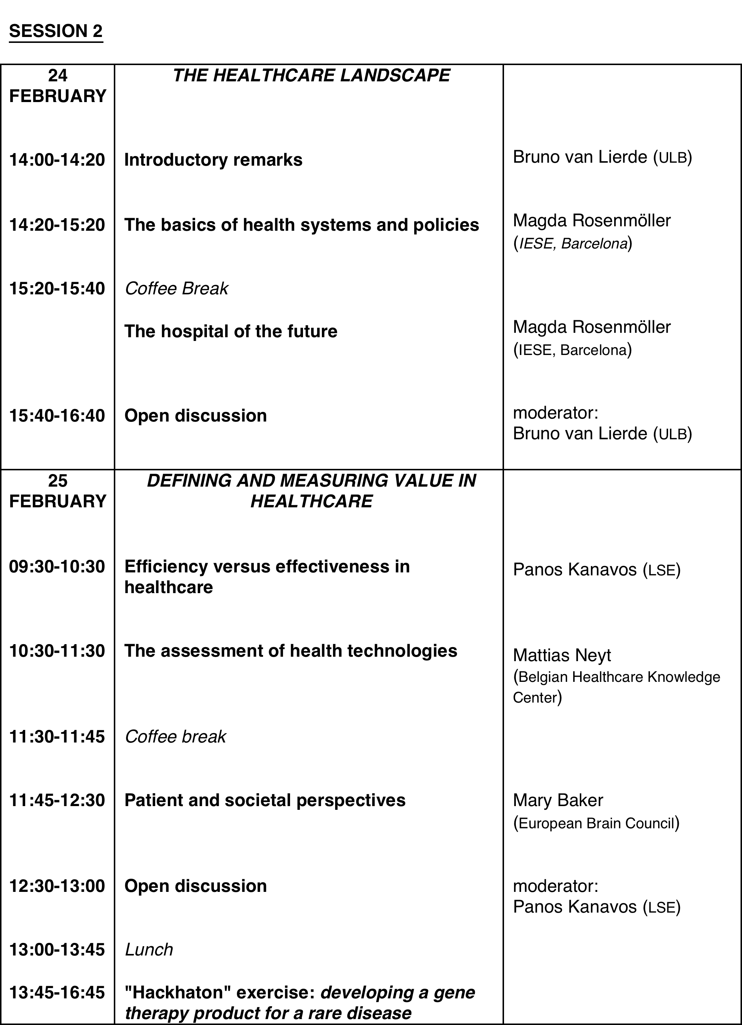
INTERFACULTY MODULE IN TRANSLATIONAL MEDICINE: DRAFT PROGRAM 2017

Slide 4
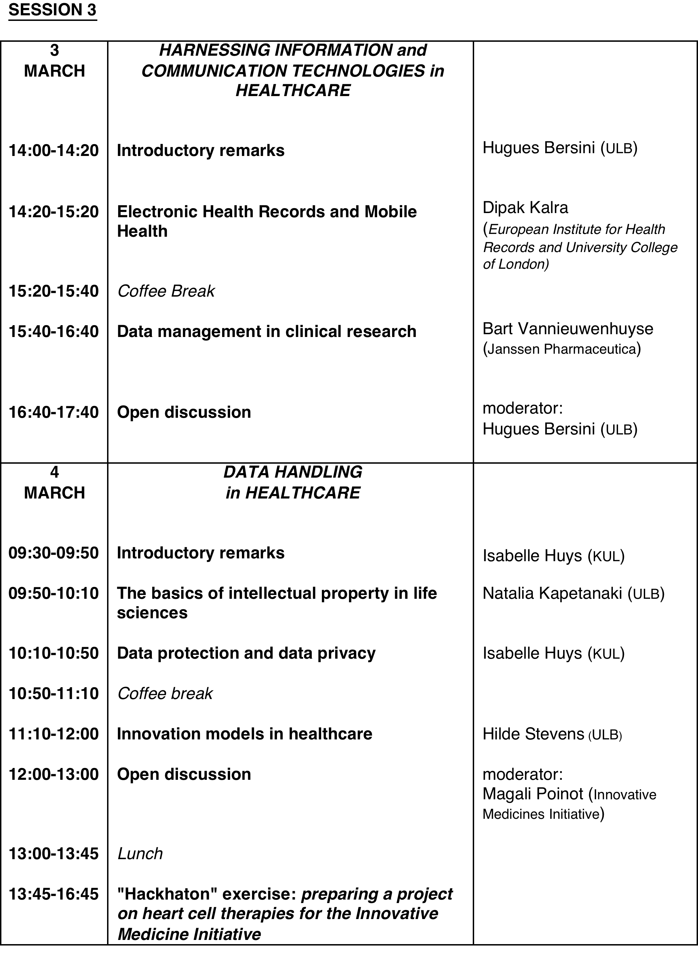
INTERFACULTY MODULE IN TRANSLATIONAL MEDICINE: DRAFT PROGRAM 2017

Slide 5
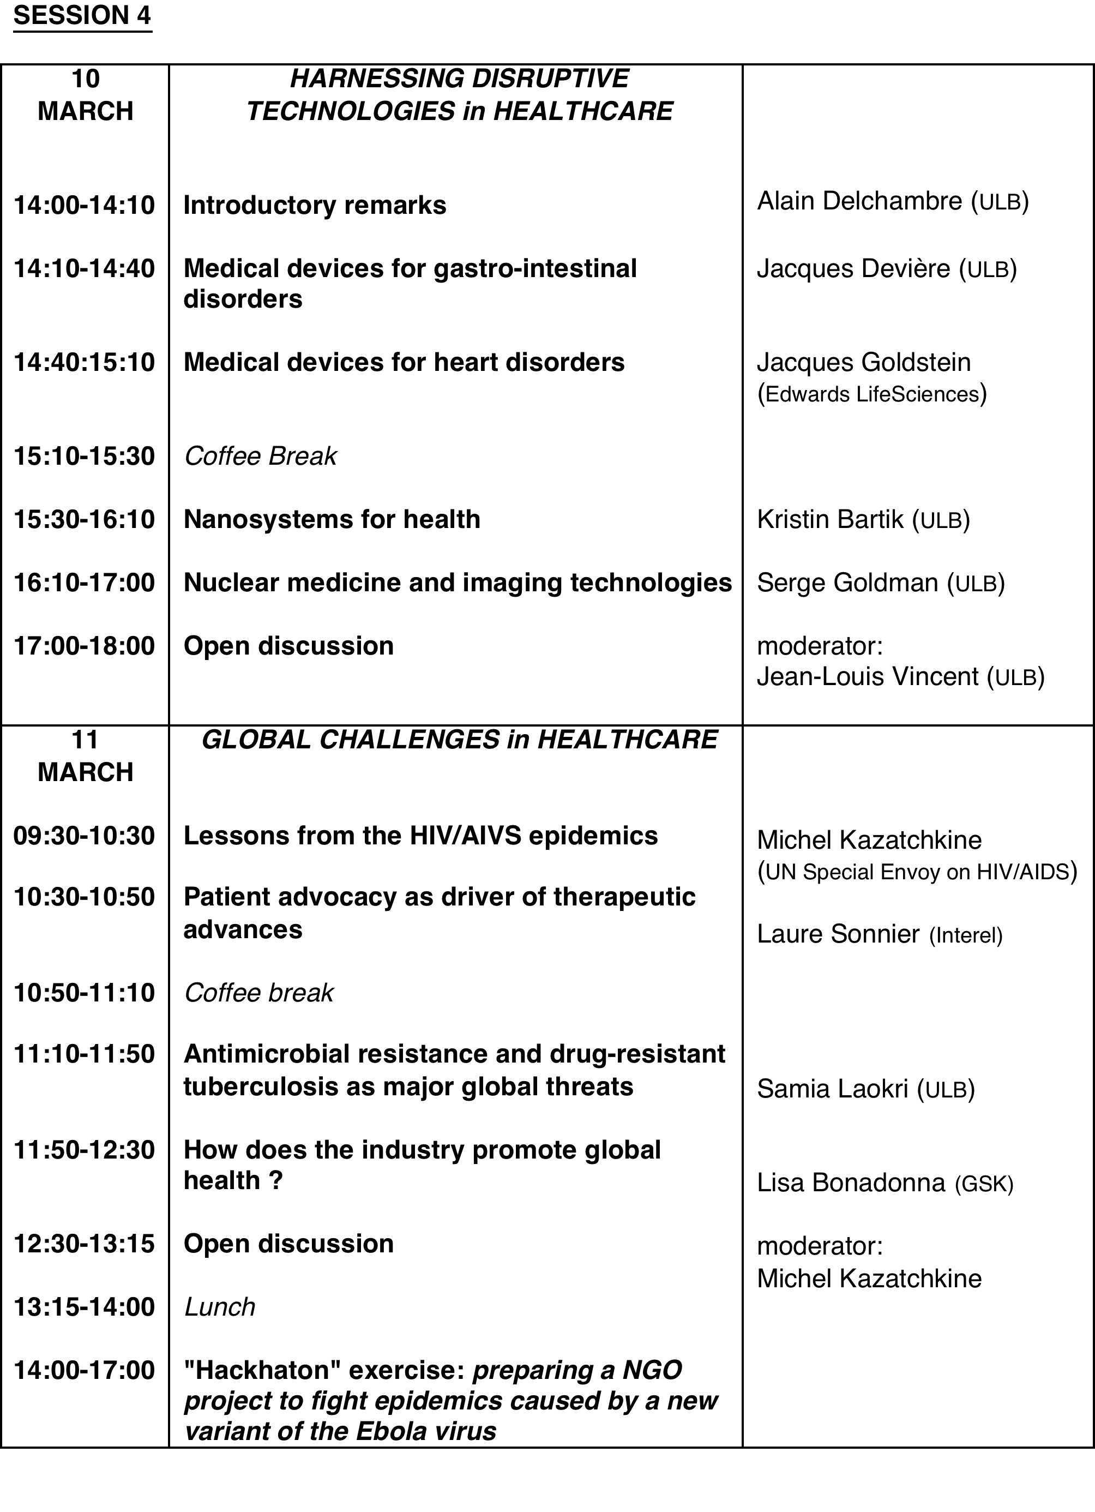
INTERFACULTY MODULE IN TRANSLATIONAL MEDICINE: DRAFT PROGRAM 2017

Slide 6
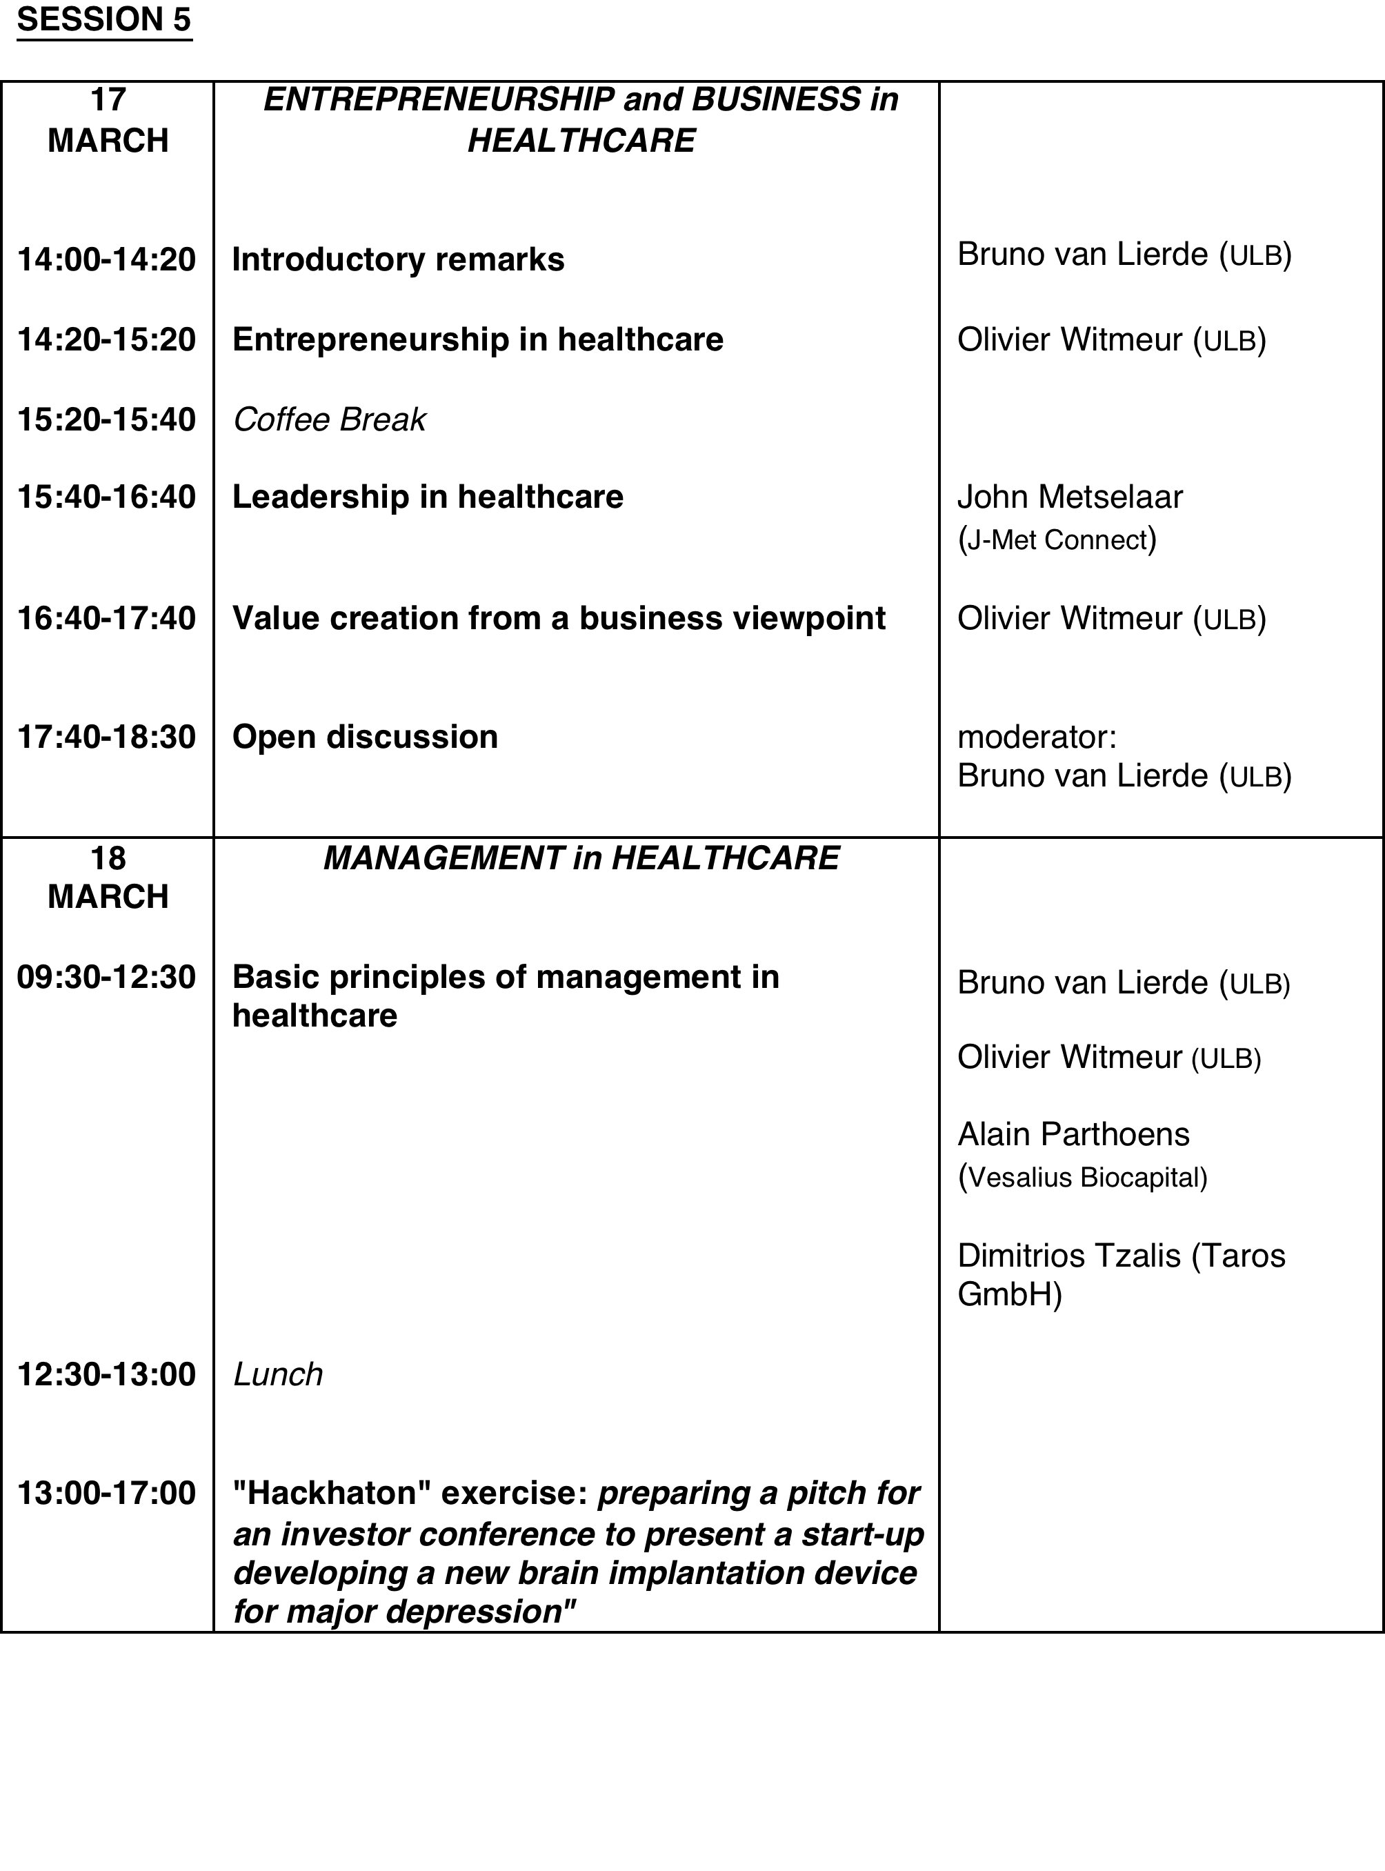
INTERFACULTY MODULE IN TRANSLATIONAL MEDICINE: DRAFT PROGRAM 2017

